Slide 1
Computational Intelligence & Machine Learning Introduction

Slide 2
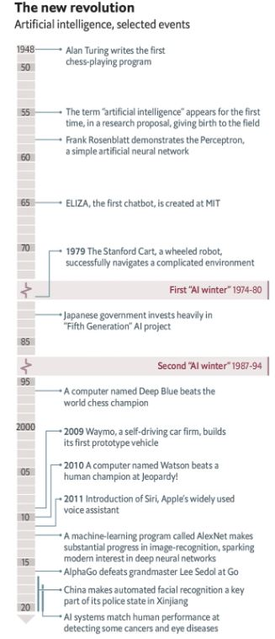

Slide 3
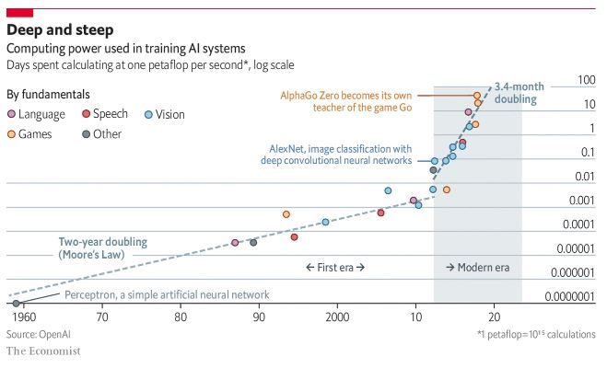

Slide 4
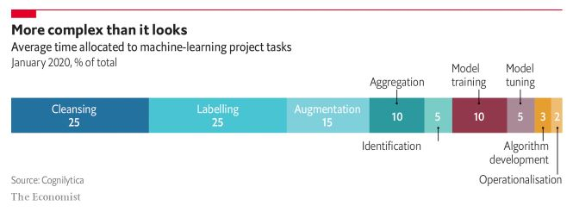
Time allocated to ML projects tasks

Slide 5
What is Learning?
Modify behavior by experience
How does the brain learn?
Strengths of synaptic connections vary
Hebb’s rule
If two neurons connected by a synapse fire simultaneously then the synapse strengthens
If two neurons connected by a synapse do not fire simultaneously then the synapse weakens

Slide 6
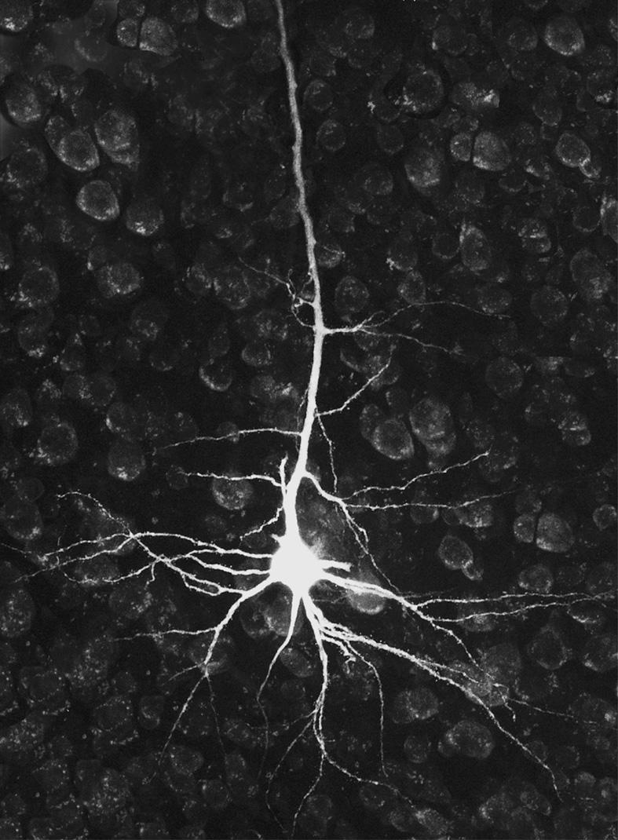
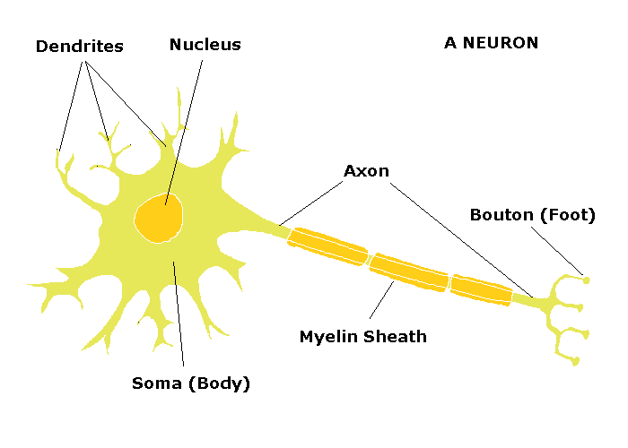
The Neuron

Slide 7
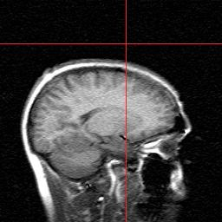
The Brain
Average human brain weighs 1.4kg
Contains around 10¹¹ neurons
Many different types
Has about 10¹⁴ synapses
Massively parallel

Slide 8
In Computational Terms
The brain
Deals with noisy, and even inconsistent data (the later much better than a computer)
Produces correct answers from high-dimensional data (usually images)
And does so quickly!
How does this work?

Slide 9
Learning
We are interested in learning from data
Human behavioural terms
Learning from experience
Remembering
The last time we saw this data,
Adapting
we tried … which worked (or not) so we’ll do the same (or something different) this time
Generalizing
In a similar situation, … worked well so we’ll try it here

Slide 10
What is Learning?
Key role in statistics, computer science (data mining / AI) and engineering
Some examples:
Predict whether a patient, hospitalised for a heart attack, will have a second attack.
Use demographic, diet and clinical measurements
Predict the price of a stock in 6 months
Use company performance and economic data
Identify risk factors for prostate cancer
Use clinical and demographic models

Slide 11
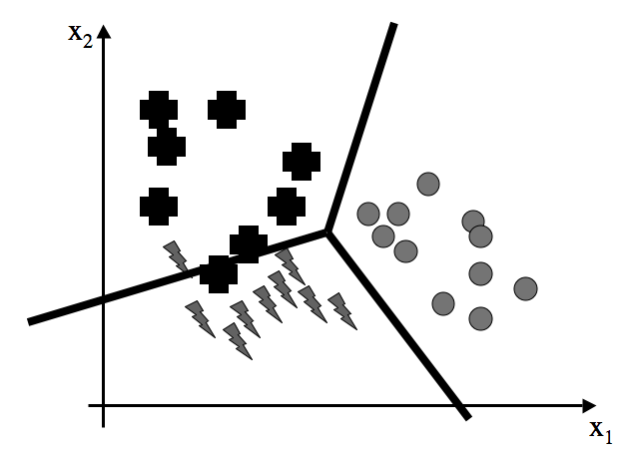
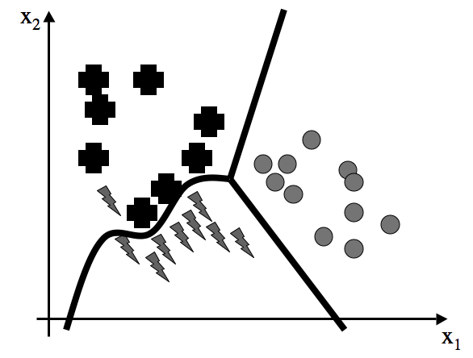
Example: Classification
Discrete problem
Each data point belongs to exactly one class
The set of classes covers the output space

Slide 12
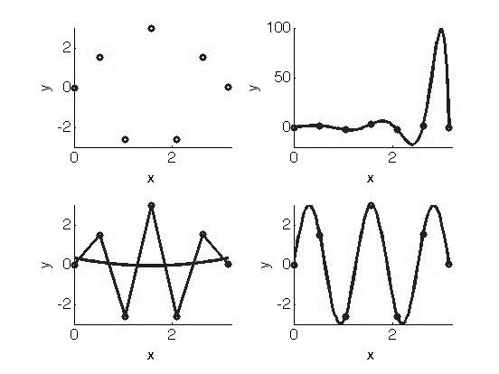
Example: Regression
Which of these is the best way to predict values
between the known data points?

Slide 13
Regression
Curve Fitting (with noise)
Function Approximation

Slide 14
Learning
Generalization
Produce sensible outputs for inputs that were not seen in learning.

Slide 15
Learning
Modify or adapt predictions
Increase ‘accuracy’
Supervised learning
Training set of examples with targets
Algorithm generalizes to all inputs
Unsupervised learning
No targets
Algorithm categorizes by identifying similarities between the inputs
Reinforcement learning
Somewhere in between supervised and unsupervised
The algorithm is told if it got the answer correct, but is not given the correct answer
Has to explore new solutions and exploit old ones
Evolutionary learning
Simulates biological evolution
Solutions improve through ‘breeding’ of current solutions

Slide 16
Supervised Learning
Have inputs x_{i} and outputs y_{i}, where i = 1,…,N
Want a relation between x and y, so we can generalize to get a y for x’s that aren’t present in the data
Also allows us to cope with 'noise' in the data

Slide 17
Hodgkin-Huxley Model
Take a real neuron (from a giant squid)
Take lots of measurements of chemical concentrations
Monitor the membrane potential
Write down the differential equations
Win the Nobel prize

Slide 18
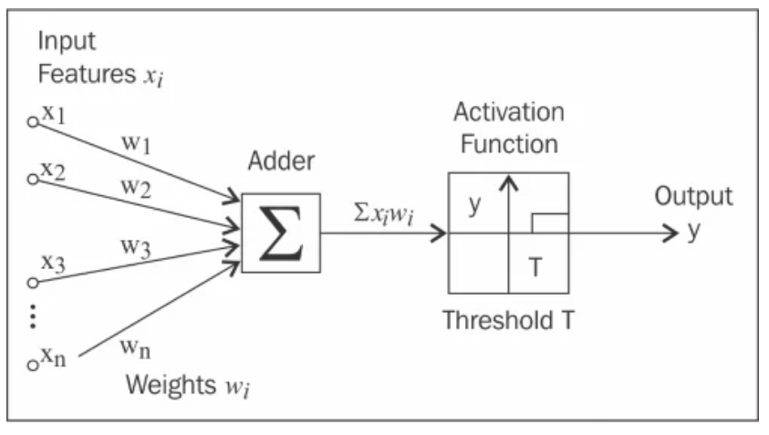
McCulloch and Pitts Neurons (1943)
Greatly simplified biological neurons
Sum the inputs
If total is less than some threshold, neuron fires
Otherwise does not

Slide 19
McCulloch and Pitts Neurons
The weight w_{j} can be positive or negative
Inhibitory or exitatory
Use only a linear sum of inputs
No refractory period
Use a simple output instead of a pulse (spike train)

Slide 20
Python for Machine Learning
Relatively simple programming language
Nice syntax
Lots of extensions
Open source, multiple platforms

Slide 21
NumPy
Numerical Python
Aims at MATLAB syntax

Slide 22
SciPy
SciPy is an open source Python library used by scientists, analysts, and engineers doing scientific computing and technical computing.
SciPy contains modules for optimization, linear algebra, integration, interpolation, special functions, FFT, signal and image processing.
SciPy builds on the NumPy array object and is part of the NumPy stack which includes tools like Matplotlib, pandas and SymPy. There is an expanding set of scientific computing libraries that are being added to the NumPy stack every day. This NumPy stack has similar users to other applications such as MATLAB, GNU Octave, and Scilab. The NumPy stack is also sometimes referred to as the SciPy stack.

Slide 23
scikit-learn
Simple and efficient tools for data mining and data analysis
Accessible to everybody, and reusable in various contexts
Built on NumPy, SciPy, and matplotlib

Slide 24
Theano
Theano is a Python library that allows you to define, optimize, and evaluate mathematical expressions involving multi-dimensional arrays efficiently. Theano features:
tight integration with NumPy.
transparent use of a GPU – Perform data-intensive calculations up to 140x faster than with CPU.
efficient symbolic differentiation – Theano does your derivatives for function with one or many inputs.
dynamic C code generation – Evaluate expressions faster.
extensive unit-testing and self-verification – Detect and diagnose many types of errors.

Slide 25
Pylearn2
Pylearn2 is a machine learning library. Most of its functionality is built on top of Theano.
This means you can write Pylearn2 plugins (new models, algorithms, etc) using mathematical expressions, and Theano will optimize and stabilize those expressions for you, and compile them to a backend of your choice (CPU or GPU).
Pylearn2 differs from scikit-learn in that Pylearn2 aims to provide great flexibility and make it possible for a researcher to do almost anything, while scikit-learn aims to work as a “black box” that can produce good results even if the user does not understand the implementation.

Slide 26
Tensorflow (1)
TensorFlow is an open source software library for numerical computation using data flow graphs. Nodes in the graph represent mathematical operations, while the graph edges represent the multidimensional data arrays (tensors) communicated between them.
The flexible architecture allows you to deploy computation to one or more CPUs or GPUs in a desktop, server, or mobile device with a single API.

Slide 27
Tensorflow (2)
TensorFlow was originally developed by researchers and engineers working on the Google Brain Team within Google's Machine Intelligence research organization for the purposes of conducting machine learning and deep neural networks research, but the system is general enough to be applicable in a wide variety of other domains as well.

Slide 28
Keras: The Python Deep Learning library
Keras is a high-level neural networks API, written in Python and capable of running on top of TensorFlow or Theano.
It was developed with a focus on enabling fast experimentation. Being able to go from idea to result with the least possible delay is key to doing good research.
Supports both convolutional networks and recurrent networks, as well as combinations of the two.
Runs seamlessly on CPU and GPU.

Slide 29
Caffe
Caffe is a deep learning framework made with expression, speed, and modularity in mind. It is developed by Berkeley AI Research and by community contributors.
It is open source, written in C++, with a Python interface.

Slide 30
PyTorch
PyTorch is a Python package that provides two high-level features:
Tensor computation (like numpy) with strong GPU acceleration
Deep Neural Networks built on a tape-based autograd system
You can reuse your favorite Python packages such as numpy and scipy to extend PyTorch when needed.

Slide 31
Recent ML Software
Myia, by the Theano team, differentiates and compiles a subset of Python to high-performance GPU code.
Swift for TensorFlow extends Swift so that compatible functions can be compiled to TensorFlow graphs.
The Flux ecosystem is extending Julia’s compiler with a number of ML-focused tools, including first-class gradients, just-in-time CUDA kernel compilation, automatic batching and support for new hardware.

Slide 32
Python Features
Python is interpreted
Can use as a ‘calculator’
It is strongly typed
Have to be careful with floats (a/2 or a/2.0)
Works by reference
a=b makes a reference to b in a, not a copy

Slide 33
Python Lists
Basic data structure
Newlist = [0, 3, 2, ‘h’]
We will mostly use it as an array in NumPy
B = array([3,4,5])
C = array([[1,2,3],[4,5,6]])
A = B

Slide 34
Python Lists
Note 0 indexing
Can also start from other end:
B[-1], etc.
To get size of arrays, use len(), shape()
Slice operator
C[:,1] and C[1,:]

Slide 35
Multiplication, etc.
Standard numpy multiplication is elementwise
Matrix multiplication uses dot(a,b)
Matrix exponentiation pow(a,2)
Inner product inner(a,b)

Slide 36
Random Numbers
from numpy.random import *
random.rand(matsize)
random.randn(matsize)
random.normal(mean,stdev,matsize)
random.uniform(low,high,matsize)
random.randint(low,high,matsize)

Slide 37
Linear Algebra
from numpy import linalg
linalg.inv
linalg.pinv
linalg.det
linalg.eig
linalg.svd

Slide 38
Plotting
from pylab import *
plot(x,y,’o-’)

Slide 39
That’s the basics
There is lots more
Optimization (in SciPy)
Statistics
Filtering
Write some programs

Slide 40
Recommended Reading
Building Machine Learning Systems with Python, Willi Richert, Luis Pedro Coelho, Second Edition, PACKT Publishing, 2015, open access – very introductory
Hands-On Machine Learning with Scikit-Learn, Keras, and TensorFlow: Concepts, Tools, and Techniques to Build Intelligent Systems , 2nd Edition, 2019 – more advanced

